Slide 1
DATA SCIENCE
AGCS-21701

Slide 2


Slide 3
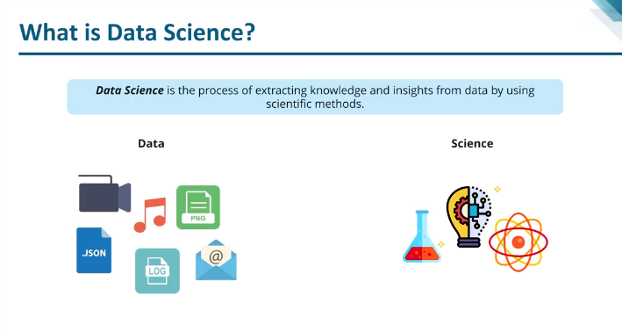
Data Science is a multidisciplinary field that focuses on extracting insights from data using a combination of scientific methods, processes, algorithms, and systems. It involves data analysis, machine learning, data mining, and big data technologies to understand and analyze actual phenomena with data.

Slide 4
Evolution of Data Science
1960s-1980s: Data science began with statistics and basic data analysis, focusing on data collection and summarization.
1990s: Introduction of data warehousing and business intelligence tools allowed for better data storage and reporting.
2000s: Growth of the internet led to the generation of vast amounts of data, giving rise to big data technologies and more sophisticated analytical techniques.
2010s-Present: The term "Data Science" became popular, emphasizing the integration of statistics, computer science, and domain knowledge to extract actionable insights from data.

Slide 5
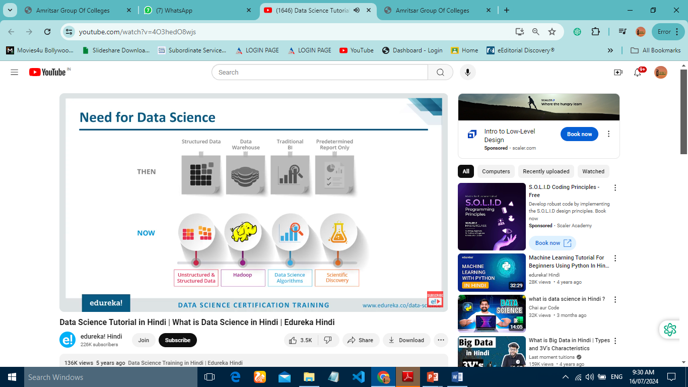
Data Explosion: The exponential growth of data requires sophisticated methods to process and analyze it.
Informed Decision-Making: Businesses and organizations need data-driven insights to make better
decisions.
Innovation: Data science drives innovation across various fields by uncovering patterns and trends that were previously hidden.
Efficiency: Automating processes and optimizing operations through data-driven approaches enhances efficiency.

Slide 6
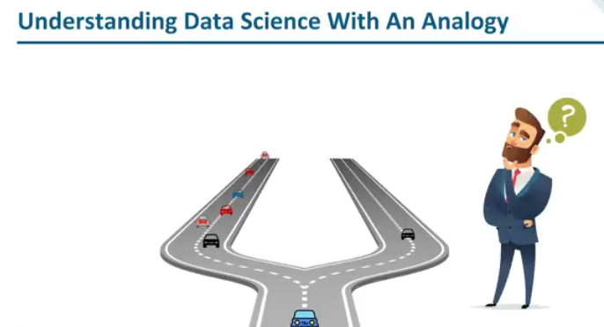

Slide 7
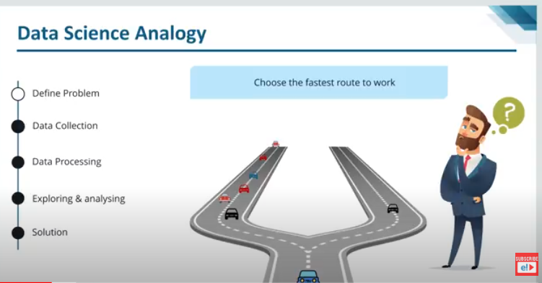

Slide 8
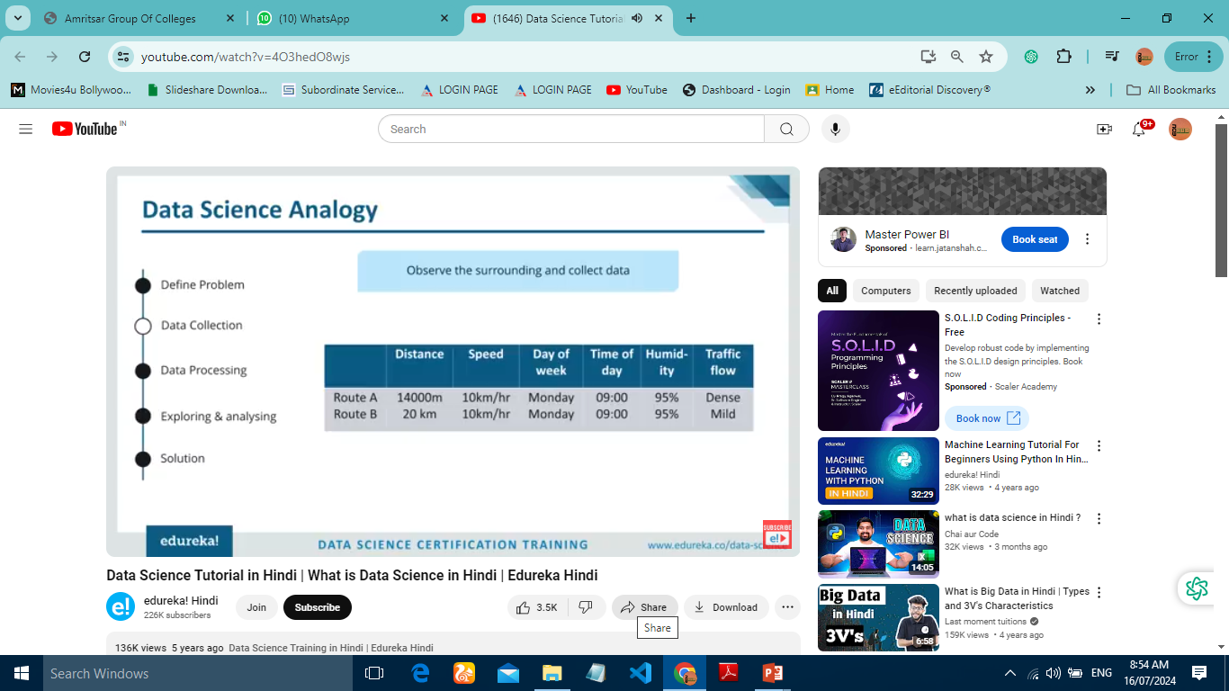

Slide 9
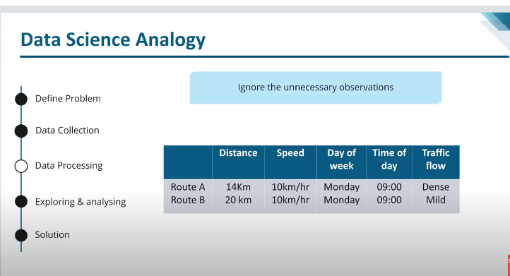

Slide 10
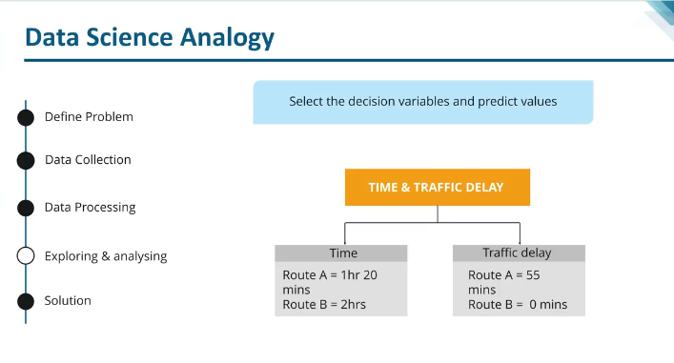

Slide 11
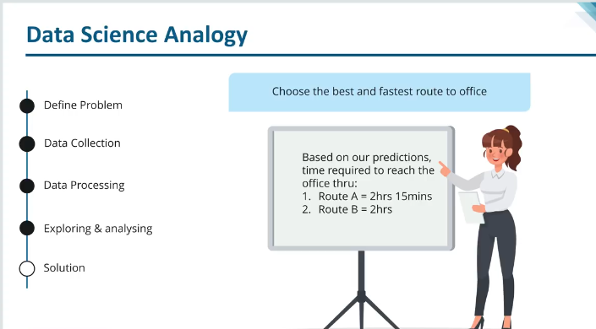

Slide 12


Slide 13
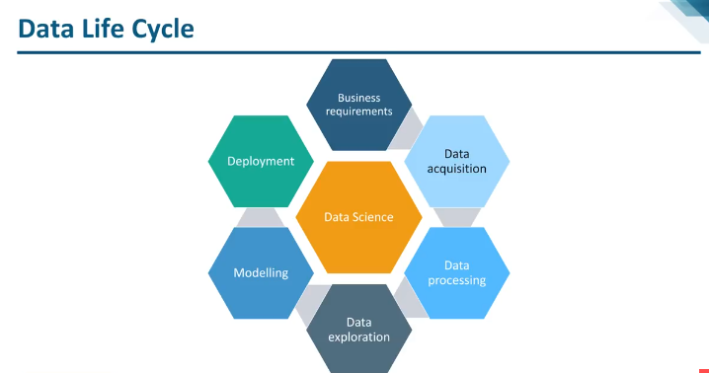

Slide 14
Data Science Process/Life Cycle
Define the Problem: Clearly articulate the problem to be solved or the question to be answered.
Data Collection: Identify and gather relevant data from various sources.
Data Cleaning: Preprocess the data to remove noise, handle missing values, and ensure consistency.
Data Exploration: Perform exploratory data analysis (EDA) to understand the data's structure and
initial patterns.
Data Modeling: Select and apply appropriate algorithms and models to the data.
Deployment: Implement the model in a production environment to make predictions or provide insights.
Monitoring and Maintenance: Continuously monitor the model's performance and update it as
needed.

Slide 15
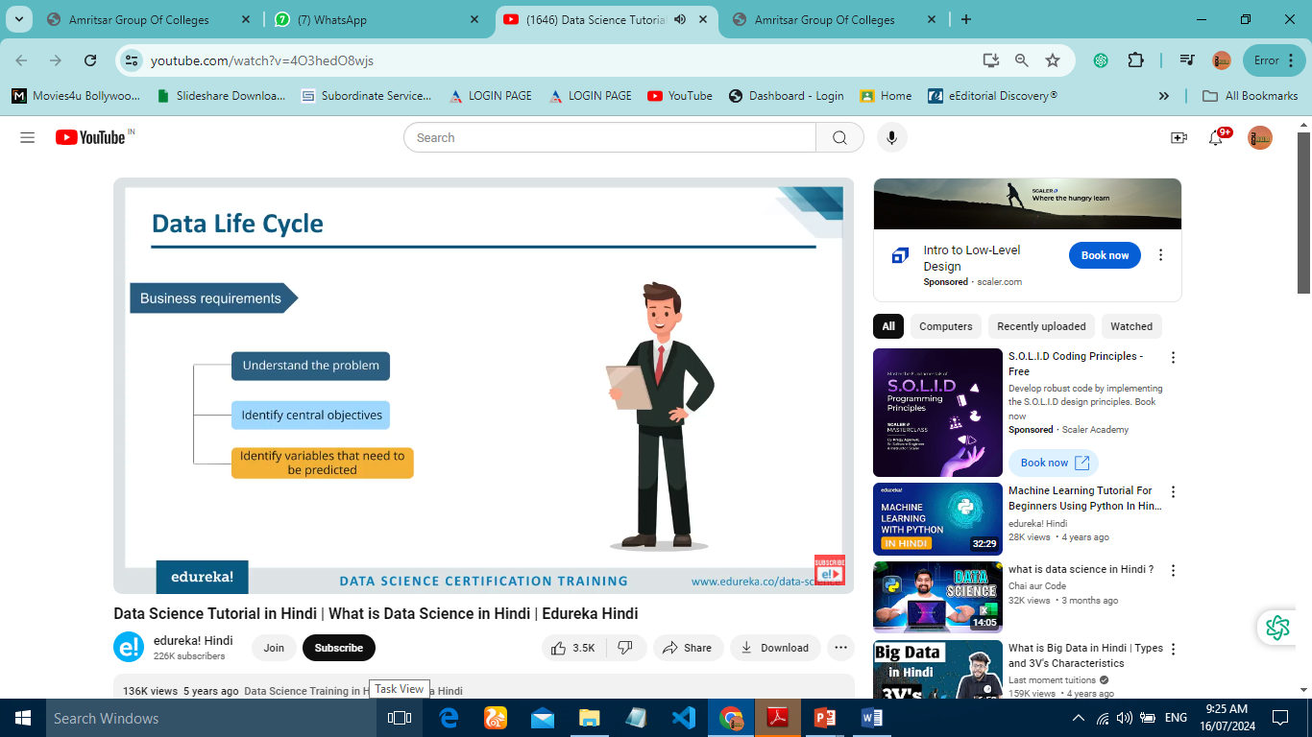
Clearly defining the business problem or research question that data science aims to address. This sets the stage for the entire data science project.

Slide 16
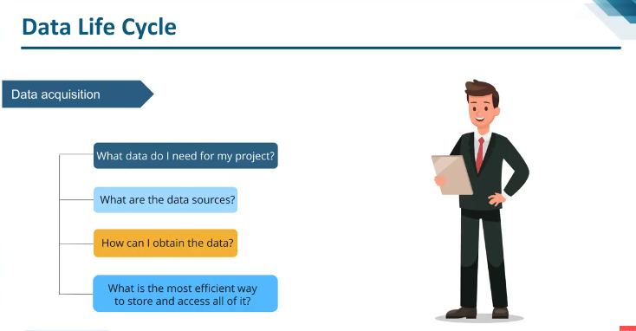
Gathering and understanding the data relevant to the problem. This involves exploring the data to identify patterns and potential insights

Slide 17
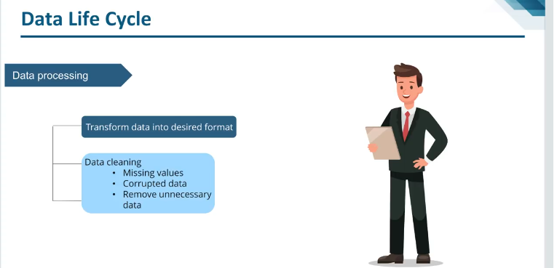
Preparing the data for analysis by cleaning, transforming, and engineering new features. This involves handling missing values, outliers, and inconsistencies.

Slide 18
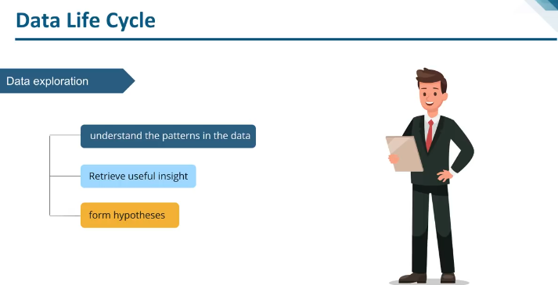

Slide 19
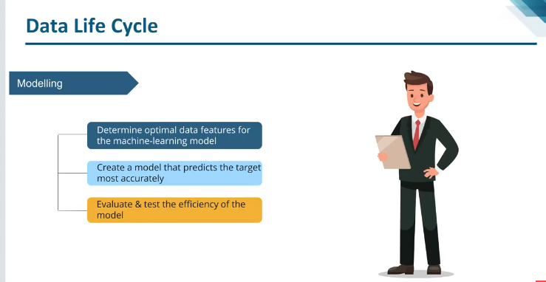
Choosing the appropriate machine learning or statistical model for the problem and training it on the prepared data. This involves optimizing the model's parameters to achieve the best performance.

Slide 20
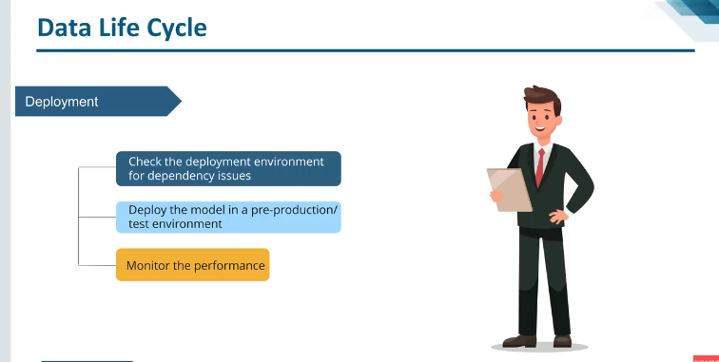
Evaluating the trained model's performance on unseen data to ensure its generalizability and reliability. Once deemed satisfactory, the model is deployed to solve the defined problem.

Slide 21


Slide 22
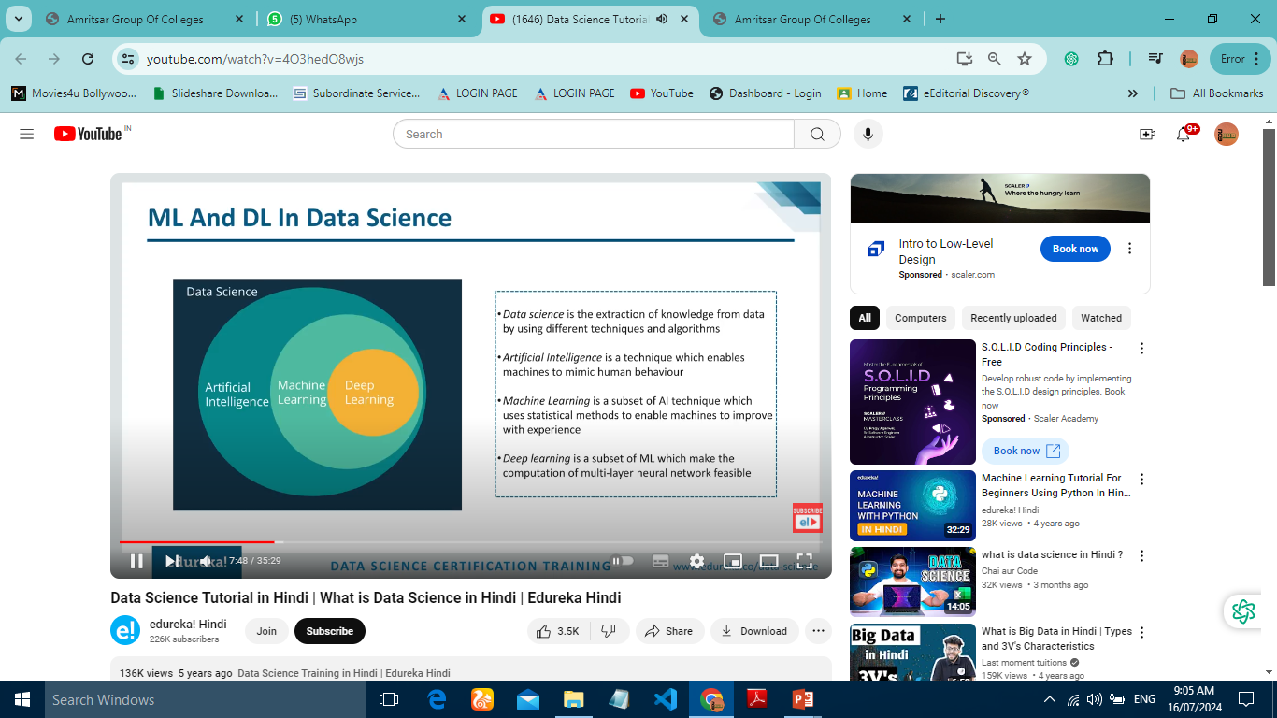

Slide 23


Slide 24
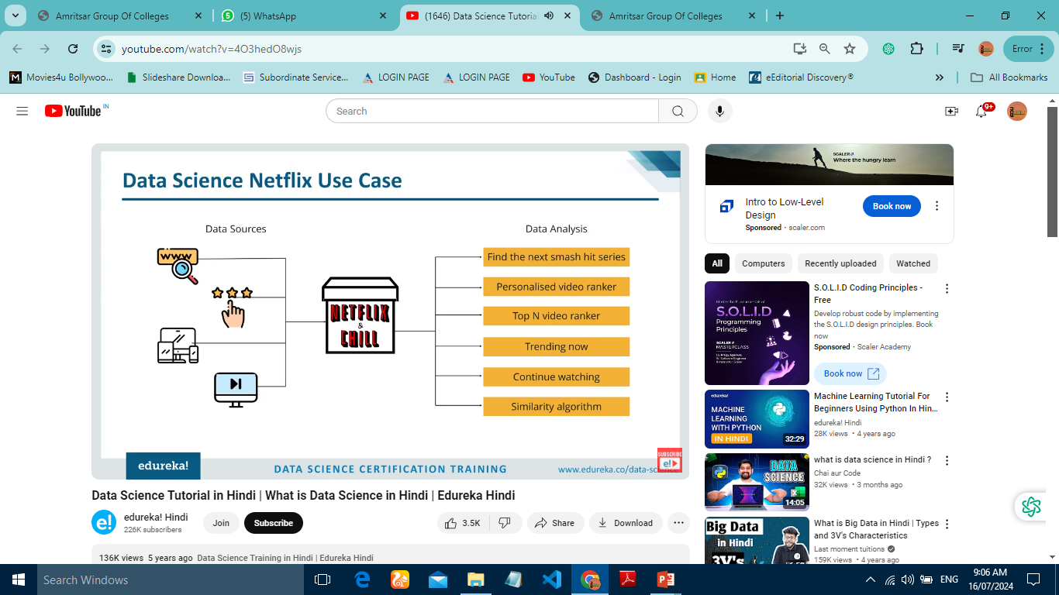

Slide 25
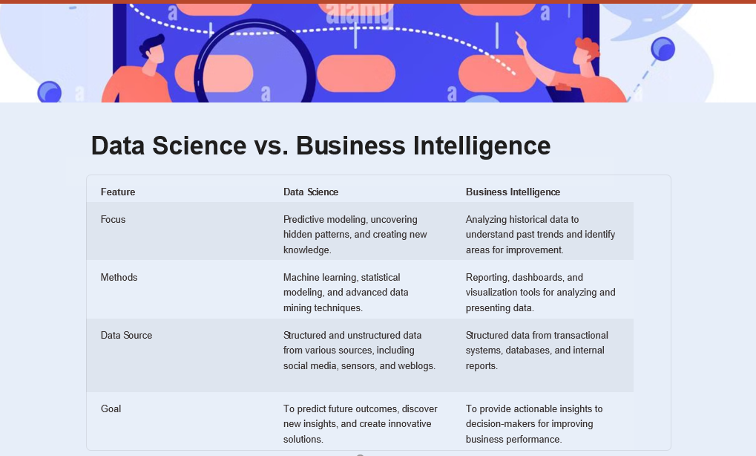

Slide 26

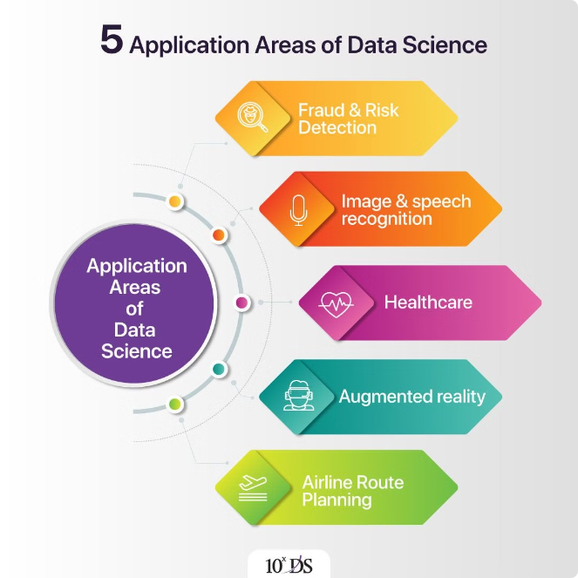
Applications of Data Science
1
Healthcare
Predictive diagnostics, personalized treatment plans, drug discovery, disease outbreak prediction, and improving patient outcomes.
2
Finance
Fraud detection, risk assessment, algorithmic trading, customer profiling, and personalized financial recommendations.
3
Retail
Customer segmentation, recommendation engines, inventory management, pricing optimization, and personalized marketing campaigns.
4
Manufacturing
Predictive maintenance, quality control, supply chain optimization, and process automation.

Slide 27

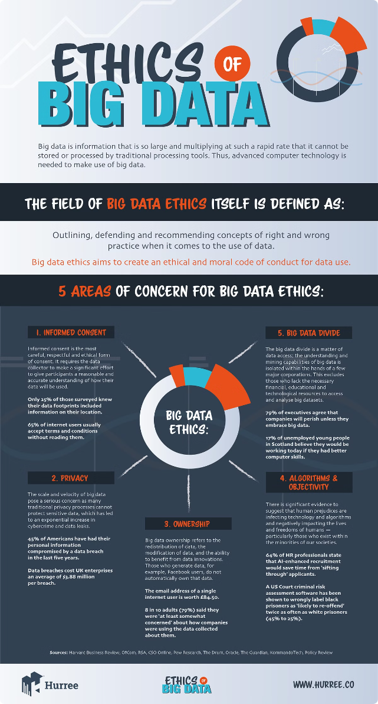




Ethical Issues in Data Science
Data Privacy
Protecting sensitive data and ensuring its responsible use. This involves implementing privacy-preserving techniques and complying with data protection regulations.
Data Security
Safeguarding data from unauthorized access, modification, or disclosure. This involves implementing robust security measures to protect data integrity and confidentiality.
Bias and Fairness
Addressing biases in data and algorithms to ensure fair and unbiased outcomes. This involves identifying and mitigating biases to promote equity and inclusivity.
Transparency and Explainability
Making data science models and their decision-making processes transparent and explainable. This fosters trust and accountability in data-driven decisions.

Slide 28

Responsible Data Use
Data Governance
Establishing clear policies and procedures for data management, access, and usage. This ensures responsible data handling and compliance with ethical guidelines.
Data Literacy
Promoting data literacy among individuals and organizations. This involves fostering understanding of data concepts, analysis techniques, and ethical considerations.
Data Impact Assessment
Evaluating the potential impact of data science projects on society, individuals, and the environment. This helps to identify and mitigate potential risks and ensure responsible use of data.

Slide 29
